Slide 1
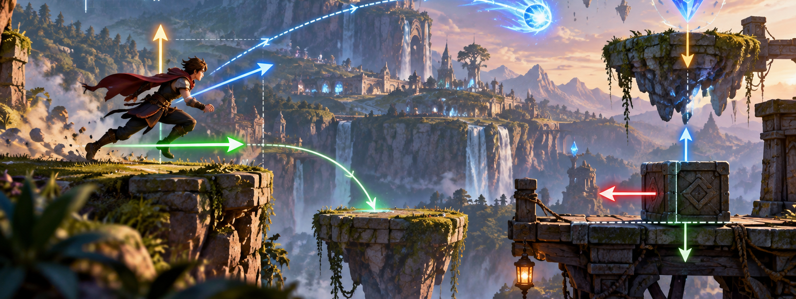

CO1035: Lecture 3b
Math vectors

Slide 2
Lecture’s objectives
Understand what vectors and scalars are
Differentiate between scalars and vectors.
Differentiate between global and local coordinates.
Find the vector between two points
Add and subtract vectors
Calculate the length of a vector.
Normalize a vector.
Perform scalar multiplication of vectors.

Slide 3
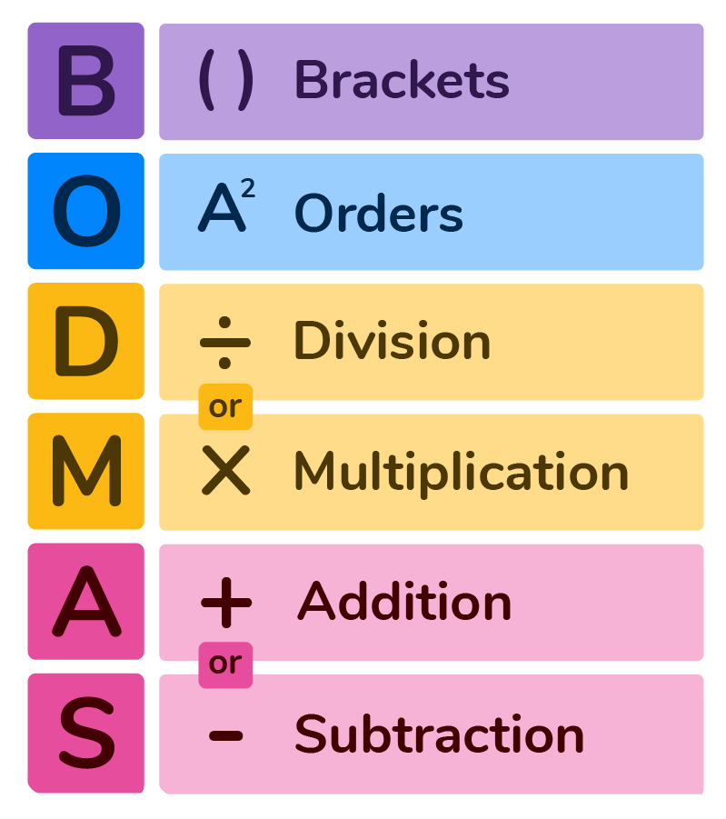
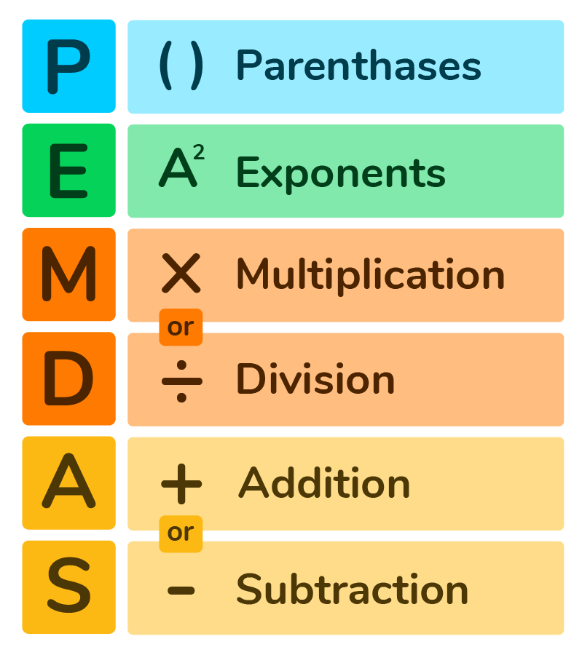
ORDER OF PRECEDENCE
(ORDER OF OPERATIONS)
Mathematical operations have an order of precedence.
Easier to remember as BODMAS or PEMDAS
Notes:
  Multiplication and Division have the same weight.
  Addition and Subtraction have the same weight.

Slide 4
RIGHT-ANGLE TRIANGLES
A right-angle triangle is a triangle that has one angle equal to 90°
Hypotenuse
Hypotenuse
Opposite
Opposite
Adjacent
Adjacent

Slide 5
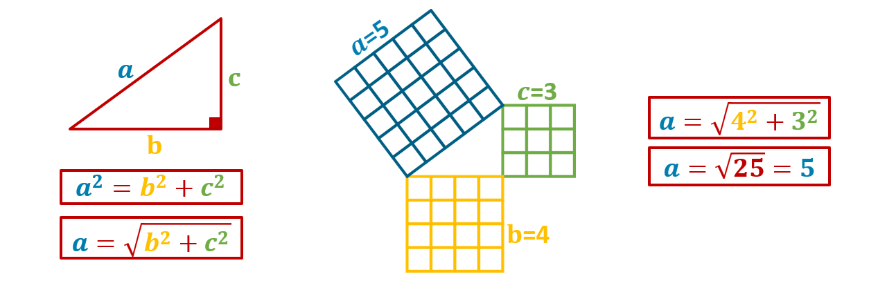
Right-angle triangles
One of the properties of right-angle triangles is Pythagoras’ Theorem.
Pythagoras' Theorem: the length of the longest side of a right-angled triangle is equal to the square root of the sum of the squares of the other two sides.
The longest side of a right-angled triangle is called the ‘hypotenuse’.

Slide 6
SCALARS AND VECTORS
Scalar: a physical quantity that is completely described by its magnitude
    (e.g.) Distance, Volume, Time, Temperature, Mass, etc.
Vectors: a physical quantity that is fully described by its magnitude and its direction
    (e.g.) Displacement, Force, Velocity, etc.

Slide 7
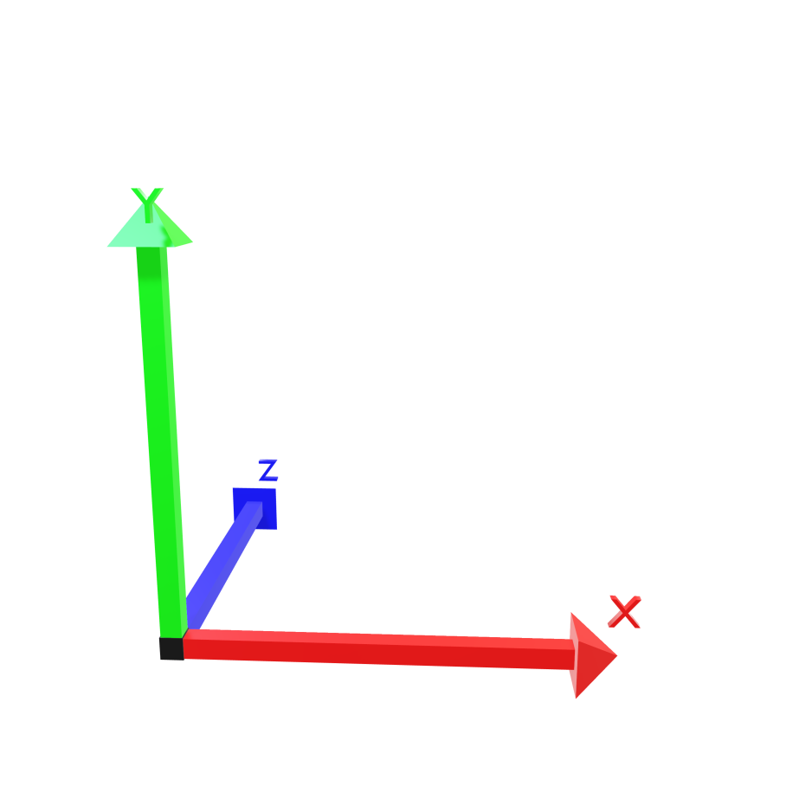
coordinates
A coordinate represents a point in space.
A point in 2D space is represented using two coordinates (x, y) e.g. (1,4)
In 3D a point is represented using three coordinates (x, y, z) e.g. (5,3,9)
In 3D - This is called Cartesian Geometry.

Slide 8
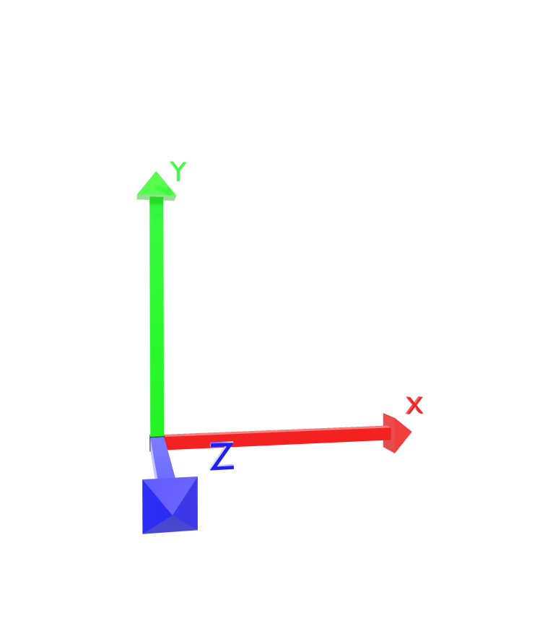
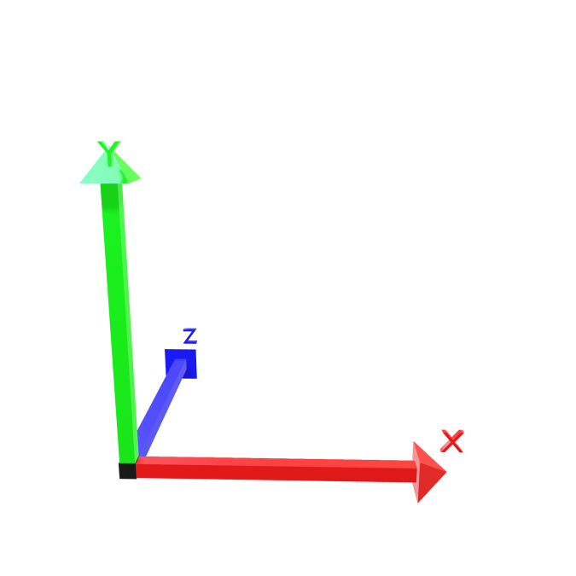
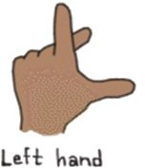

Coordinates (CONT.)
You can use your hand to indicate the geometry.
In the TL-Engine, we are using left-handed axes.
  x = thumb
  y = index finger
  z = middle finger
The origin of the grid is at ( 0, 0, 0 )

Slide 9
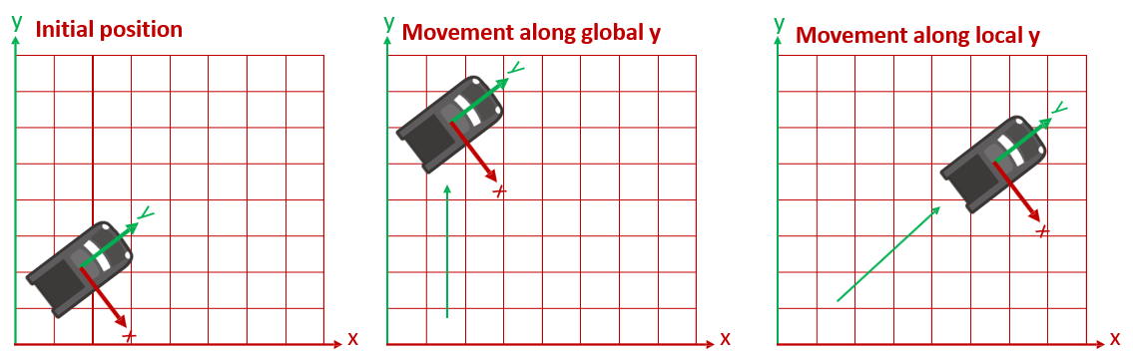
LOCAL VS GLOBAL
COORDINATES
The world (or screen) has its x, y, z axes and its own origin (Global Coordinates)
Every object in the world also has its own origin and x, y and z axes (Local Coordinates)

Slide 10
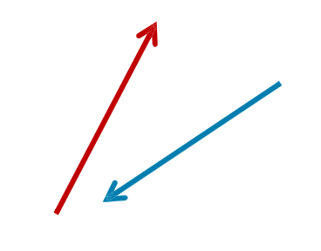
VECTORS
Vectors are entities with magnitude and direction.
We visualize vectors by drawing a line with an arrowhead at one end.
The length of the line represents the magnitude of the vector.
And the arrowhead indicates the vector’s direction

Slide 11
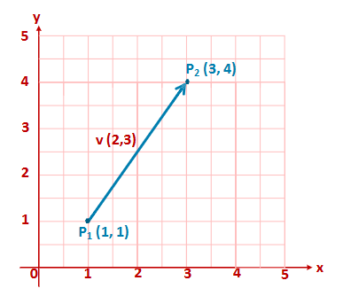
Vectors (cont.)
Vectors are useful in games, e.g., for representing movement or direction.
In 3D, a vector can be drawn if the x, y, and z coordinates of its initial and final points are known.
Vectors are more easily shown in 2D where we only need (x, y) values.
Example: This vector can be described as going upwards to the right.

Slide 12
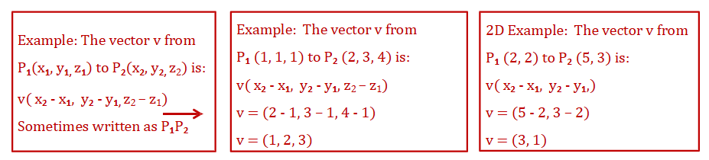
VECTOR BETWEEN TWO POINTS
The vector between two points can be calculated by subtracting one point from the other:
    Subtract the initial x value from the final x value to produce one new x;
    Subtract the initial y value from the final y value to produce one new y;
    Subtract the initial z value from the final z value to produce one new z;

Slide 13
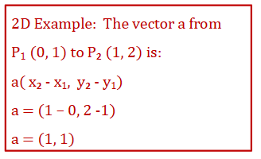
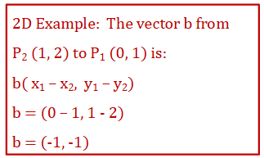
Vector direction
Notice how the values in the vector are found by subtracting the source point coordinates from the destination point coordinates.
This means that the direction of the vector is important.
And that the vector in the reverse direction from P2 to P1 is not the same as the vector from P1 to P2.

Slide 14
VECTOR DIRECTION (CONT.)
Which point is subtracted from which is important.
The order gives us the direction of movement.
Vector a from P₁ (0, 1)
to P₂ (1, 2)
Vector b from P₂ (1, 2)
to P₁ (0, 1)
y
y
5
5
4
4
3
3
2
P₂(1, 2)
2
P₂(1, 2)
1
P (0, 1)
1
1
P (0, 1)
1
0
1
2
3
4
5
x
0
1
2
3
4
5
x

Slide 15
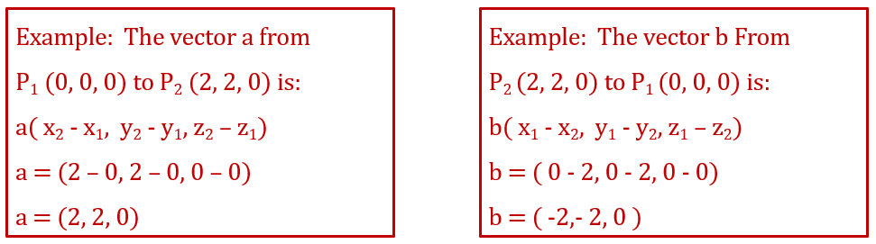
Vectors in 3d
3D vectors are just an extension of 2D vectors.
In the case of 3D vectors, we also include the z-axis in the equation.

Slide 16
Vectors (CONT.)
y
5
Vectors are location independent
The vector is the same no matter what its coordinates are.
Two vectors with the same magnitude and direction are equal regardless of their location
4
3
2
1
0
1
2
3
4
5
x

Slide 17
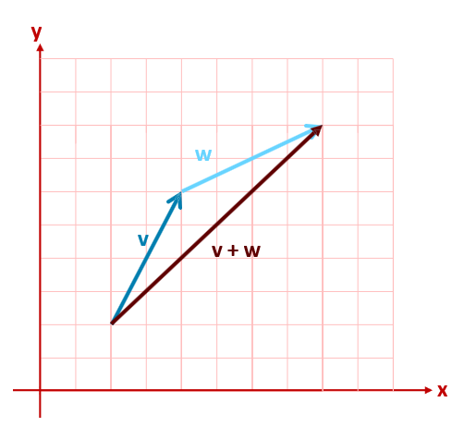
Vector Addition
Two vectors v and w are added by placing the beginning of w at the end of v.

Slide 18
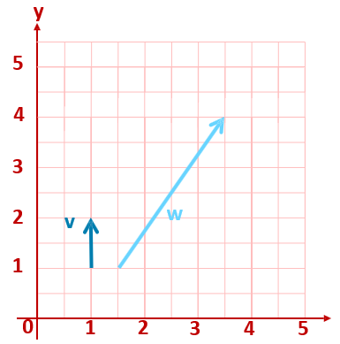
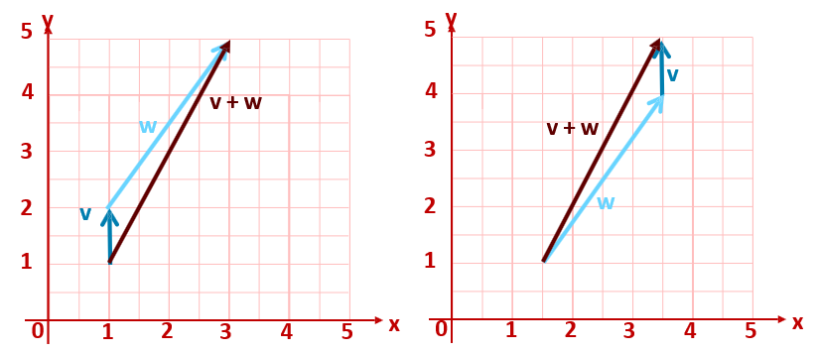
VECTOR ADDITION (CONT.)
However, since vectors are independent of the coordinates, the addition of 2 vectors will lead to the same result (e.g.)
v(0, 1) + w(2, 3) = (0+2, 1+3) = (2, 4)
w(2, 3) + v(0, 1) = (2+0, 3+1) = (2, 4)
v + w = w + v

Slide 19
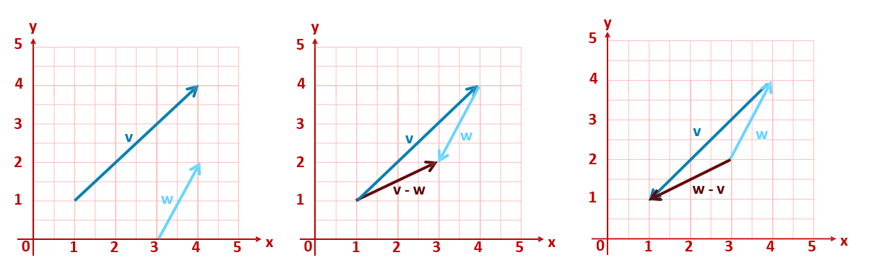
Vector Subtraction
Subtraction works in a similar way to addition.
The direction in which the subtracted vector points is effectively reversed.
v(3, 3) - w(1, 2) = (3 -1, 3 -2) = (2, 1)
Note: v(3, 3) - w(1, 2) = (2, 1) is not equals w(2, 1) - v(3, 3) = (-1, -2)

Slide 20

Length of a Vector
A vector makes a right-angled triangle.
The shortest sides of the triangle are the x and y values.
3D is the same - but with the addition of the z axis.
In 3D - If we have a vector v (x, y, z), then we can use Pythagoras’ Theorem to calculate the length of v or ||𝑣 | |
y
P₂
𝑣
𝑦
P
𝑥
1
x

Slide 21
Length of a Vector: 3D Example
What is the length of the vector (5, 6, 7)?
𝑣 = 𝒙^{𝟐} + 𝒚^{𝟐} + 𝒛^{𝟐}
𝑣 = 5^{𝟐} + 6^{𝟐} + 7^{𝟐}
𝑣 = 110 = 10.49

Slide 22
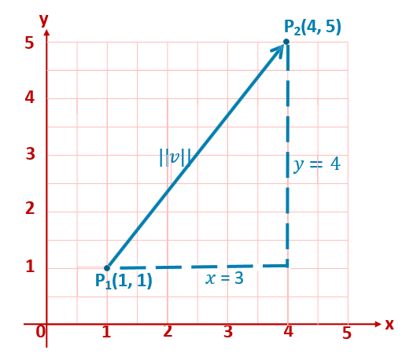
Length of a Vector:
2D Example
What is the length of the vector (3, 4)?
𝑣 = 𝟑^{𝟐} + 𝟒^{𝟐}
𝑣 = 5

Slide 23
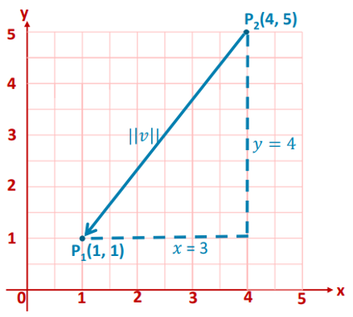
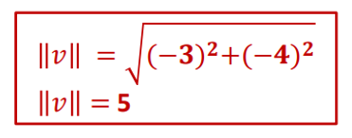
Length of a Vector:
2D Example (cont.)
What is the length of the vector (-3, -4)?

Slide 24


Why is the Length of a Vector Useful?
You may want to find out the distance between two game objects.
You may want to find out if two game objects are colliding.

Slide 25


Unit or Normalised Vector
A vector that has a magnitude equal to 1 is called a unit or a normalized vector.
Represented with a ^ symbol: e.g.
To convert a vector into a normalized vector, we need to divide its components by the length of vector

Slide 26
Direction of Movement
Remember: vectors have both magnitude and direction.
A vector can be normalised so that it represents direction; this is called a direction vector
(e.g.) both vectors are pointing in the same direction, but the black vector is half the size of the red vector.
Normalising these vectors will turn them into unit vectors so that they have the same magnitude and direction.
y
5
4
3
2
1
0
1
2
3
4
5
x

Slide 27



Direction of Movement (cont.)
Direction should be independent of scale.
As you know, the units we use within 3D graphics are arbitrary.
(e.g.) Sometimes in the TL-Engine, a distance of 0.1 is large, but sometimes it is small.
This depends on the scale of the models.
y
5
4
3
2
1
0
1
2
3
4
5
x

Slide 28
Direction Vector
The direction vector is a vector that is independent of scale; it has a length of 1.
It is used to represent the direction of a vector
y
5
4
3
2
1
0
1
2
3
4
5
x

Slide 29
The direction vector
The direction vector is found by:
  Calculating the length of the vector
  Dividing each component of the vector by its length
For example, given a vector v ( 1, 3, 6 )
𝑣 = 𝒙^{𝟐} + 𝒚^{𝟐} + 𝒛^{𝟐}
𝑣 = 𝟏^{𝟐} + 𝟑^{𝟐} + 𝟔^{𝟐}
𝑣 = 6.78
Direction vector:
=
𝟏 𝟑
𝟔
, ,
𝟔.𝟕𝟖 𝟔.𝟕𝟖 𝟔.𝟕𝟖
= (0.15, 0.44, 0.88)

Slide 30
The direction vector 2d example
Here is a 2D example of the process:
y
𝑣 = 𝒙^{𝟐} + 𝒚^{𝟐}
5
 |  |  |  | v (0.8 |  | , 0.6)
 |  |  |  | Dir
 |  | P₁(1,1)
𝑣 = 𝟒^{𝟐} + 𝟑^{𝟐}
𝑣 = 5
4
P₂(5,4)
3
2
Direction vector:
𝟒 , 𝟑
1
=
𝟓 𝟓
= (0.8, 0.6)
0
1
2
3
4
5
x

Slide 31
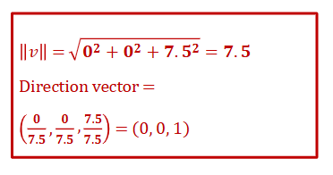
The direction vector 3d example
Vector pointing straight forward: ( 0, 0, 3.1 )

Slide 32

Pointing/looking at
Vectors can be used to represent a direction (in the sense of North or North-West).
To do this, we create a vector that ‘points’ in the direction we want, and has a length of 1 unit.
In games, we often need to find the direction vector that ‘points’ from one position to another.
The process we use is:
    Get the vector between the two positions v(x, y, z)
    Find the length of this vector 𝑣 (using Pythagoras)
    The direction vector in this case is:

Slide 33


Scalar Multiplication
y
Direction vectors are always of length 1 (the unit length).
To describe an actual movement, you combine the direction vector with a scalar.
The scalar is the distance to be moved.
Imagine that you want to move something by a given distance in a particular direction. We multiply the direction vector by the distance we want to move.
For example, to move an object 4 units using the normalised vector ( 0, 1, 0 ), the movement vector becomes ( 0, 4, 0 )
5
4
3
2
1
0
1
2
3
4
5
x

Slide 34
Summary
A scalar has magnitude; a vector has magnitude and direction.
The vector between two points can be calculated by subtracting one point from the other.
The length of a vector can be calculated using Pythagoras’ theorem.
Vectors can be added and subtracted.
Unit vector is a vector of length one (a normalized vector).
A direction vector is a unit vector used to represent the direction of a vector.
A vector can be scaled through scaler multiplication.

Slide 35
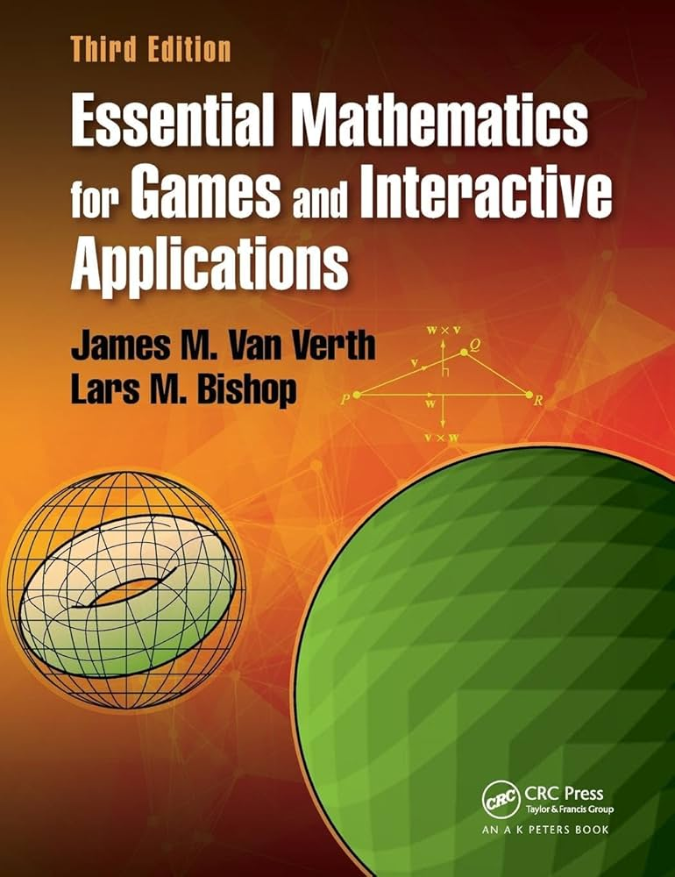
References and essential reading
Van Verthe, Essential Mathematics for Games:
  Chapter 2: "Vectors and Points"

Slide 36
Questions?!

